Slide 1
Sales Insights
Superstore Order Data Analysis
Project by omkar wable

Slide 2
Source Data — “data” Sheet
Sample rows
Range
Order ID | Customer | Region | Category | Sales | Profit
CA-2016-152156 | Claire Gute | South | Furniture | $261.96 | $41.91
CA-2016-152156 | Claire Gute | South | Furniture | $731.94 | $219.58
CA-2016-138688 | D. Van Huff | West | Office Supp. | $14.62 | $6.87
US-2015-108966 | Sean O'Donnell | South | Furniture | $957.58 | -$383.03
US-2015-108966 | Sean O'Donnell | South | Office Supp. | $22.37 | $2.52
... | ... | ... | ... | ... | ...
data!A1:U9995
Columns
Row ID • Order ID • Customer Name • Order Date • Ship Date • Ship Mode • Segment • Region • Category • Sub-Category • Sales • Quantity • Discount • Profit
▸ This flat table is the source for every pivot, chart, and dashboard visual that follows.
9,994 order line items
One row per line item across 5,009 orders, covering Furniture, Office Supplies, and Technology sales in the US.
Quick Stats
Total Sales: $2,297,201 Total Profit: $286,397
Orders: 5,009 Total Qty: 37,873

Slide 3
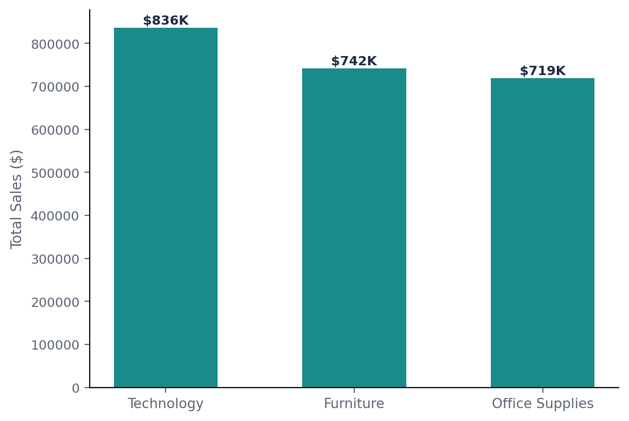
Sales by Category
Technology leads total sales, narrowly ahead of Furniture and Office Supplies.
Ranking
Category | Total Sales
Technology | $836,154
Furniture | $741,999
Office Supplies | $719,047
Profit by Category: Technology $145,455 · Office Supplies $122,491 · Furniture $18,451
▸ Furniture sells almost as much as Technology but returns 8x less profit — the weakest margin of the three categories.

Slide 4
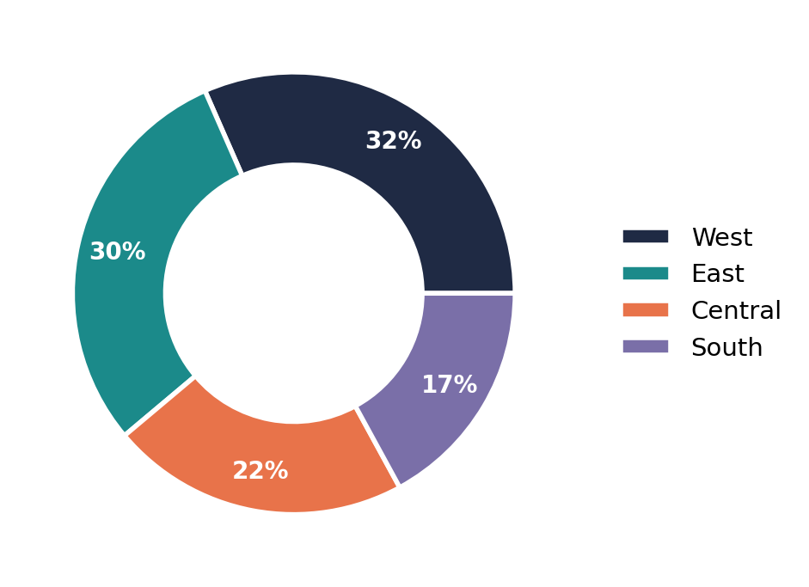
Sales by Region
How the $2.3M in total sales splits across the 4 US regions.
Breakdown
Region | Sales
West | $725,458
East | $678,781
Central | $501,240
South | $391,722
▸ West leads both sales and order volume (3,203 orders, the most of any region), while South trails on both — the two rankings move together here.

Slide 5
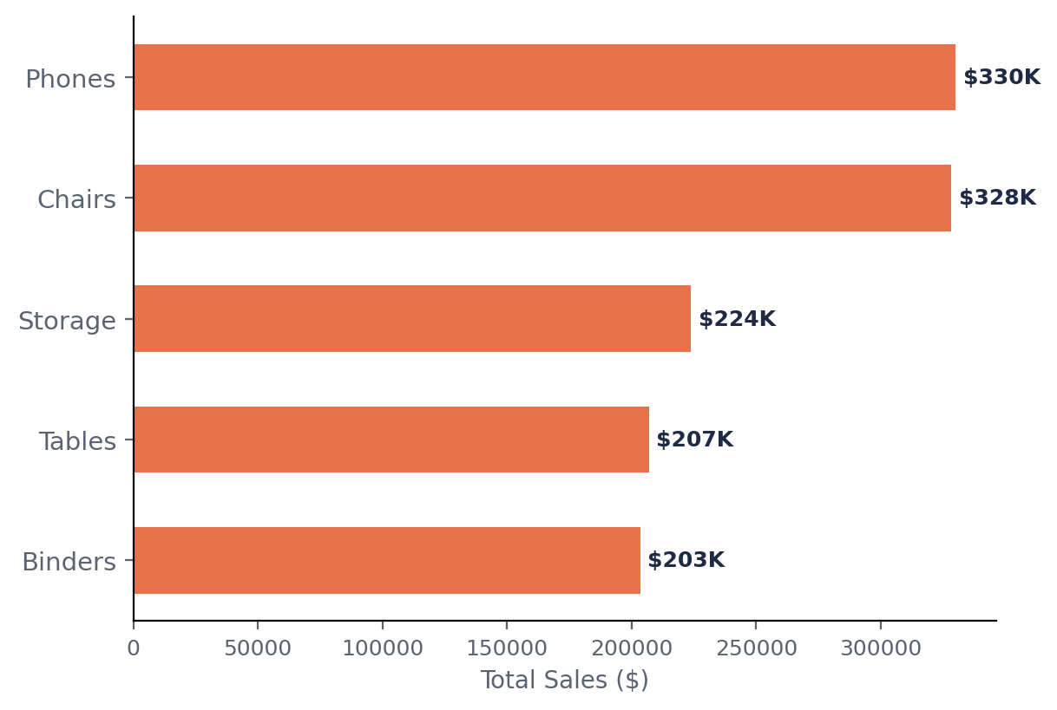
Top 5 Sub-Categories by Sales
Phones and Chairs are the two strongest sub-categories, each over $325K.
Totals
Sub-Category | Sales
Phones | $330,007
Chairs | $328,449
Storage | $223,844
Tables | $206,966
Binders | $203,413
▸ These top 5 sub-categories alone account for roughly 56% of total company sales.

Slide 6
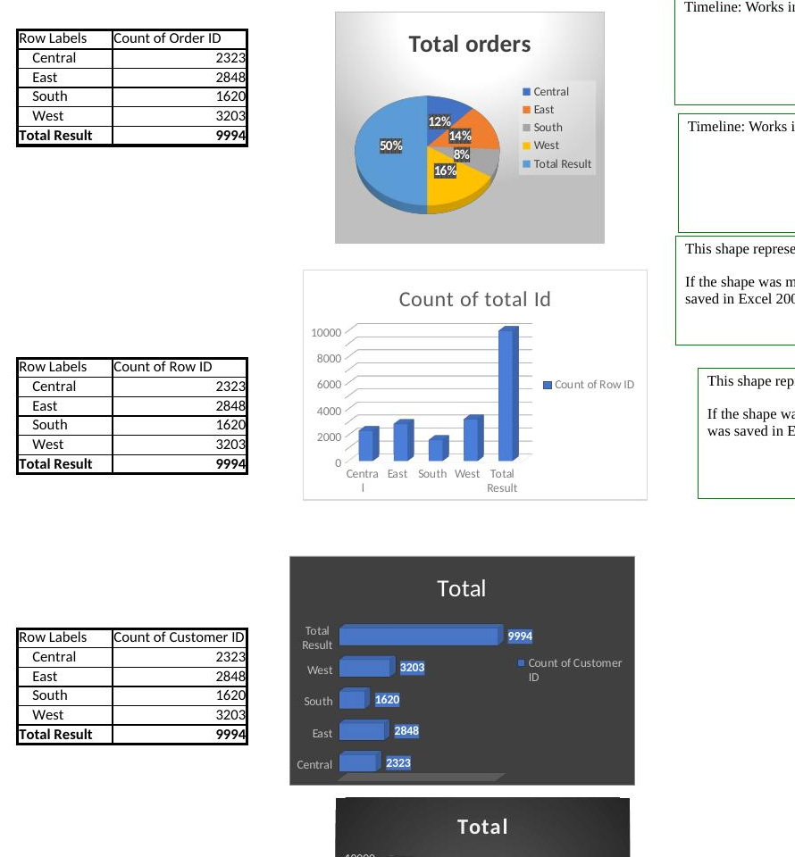
Pivot Table vs Pivot Chart
What is a Pivot Table?
What is a Pivot Chart?
A Pivot Table summarizes large amounts of raw data into a compact grid. It lets you group, filter, count, and sum rows (e.g. data!A1:U9995) by fields like Region, Category, or Customer — without writing formulas.
A Pivot Chart is a visual (bar, pie, column, etc.) built directly on top of a Pivot Table's output. It updates automatically whenever the Pivot Table refreshes, giving a live picture of the same summarized data — like the charts on this dashboard.
Pivot table screenshot

Slide 7
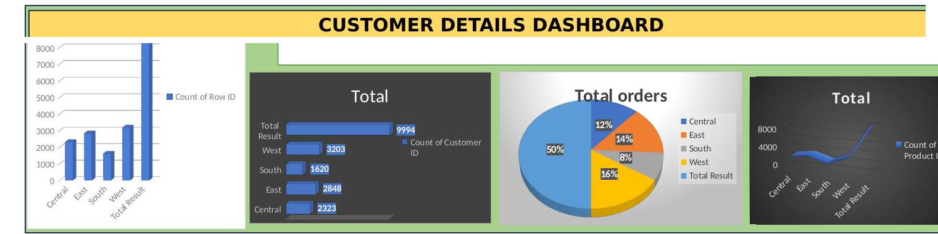
Dashboard
Customer Details Dashboard — order counts and totals by Region, built entirely from Pivot Table + Pivot Chart output.

Slide 8



